Slide 1
Swing

Slide 2
Introduction
After learning AWT, let’s now see what's Swing? Well, Swing is important to develop Java programs with a graphical user interface (GUI).
There are many components which are used for the building of GUI in Swing. The Swing Toolkit consists of many components for the building of GUI.
Swing components are also helpful in providing interactivity to Java applications. Following are components included in Swing toolkit:
list controls
buttons
labels
tree controls
table controls

Slide 3
Introduction
Swing API is set of extensible GUI Components to ease developer's life to create JAVA based Front End/ GUI Applications.
It is build upon top of AWT API and acts as replacement of AWT API as it has almost every control corresponding to AWT controls.
Swing component follows a Model-View-Controller architecture.

Slide 4
MVC architecture
A Model represents component's data.
View represents visual representation of the component's data.
Controller takes the input from the user on the view and reflects the changes in Component's data.
Swing component have Model as a separate element and View and Controller part are clubbed in User Interface elements.
Using this way, Swing has pluggable look-and-feel architecture.

Slide 5
Swing features
Light Weight - Swing component are independent of native Operating System's API as Swing API controls are rendered mostly using pure JAVA code instead of underlying operating system calls.
Native code is used by each AWT component to display itself on the screen.
For example, the buttons work as Microsoft Windows buttons when we run a Java application under Microsoft Windows.
  Same thing happens with Macintosh and UNIX.
Rich controls - Swing provides a rich set of advanced controls like Tree, TabbedPane, slider, colorpicker, table controls.
Highly Customizable - Swing controls can be customized in very easy way as visual apperance is independent of internal representation.

Slide 6
Con’t
Pluggable look-and-feel - SWING based GUI Application look and feel can be changed at run time based on available values.
Abstract Window Toolkit (AWT) and Swing, both groups of components are part of the Java Foundation Classes (JFC).

Slide 7
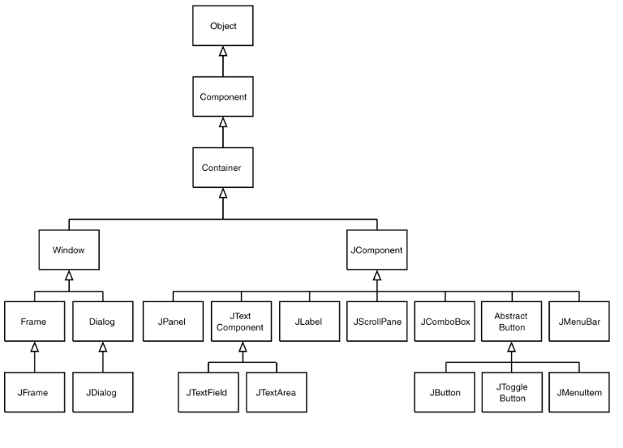
Inheritance hierarchy for the Component class

Slide 8
Introduction
Components are divided into three categories:
Container components
Ordinary components
Menu components

Slide 9
Container Components
Jframe
Jpanel
Jframe
A JFrame is an independent window that can be moved around on the screen independently.
  import javax.swing.*;
  public class FrameDemo {
  public static void main(String[] args) {
  JFrame f = new JFrame("Frame Demo");
  f.setSize(350, 250);
  f.setDefaultCloseOperation(JFrame.EXIT_ON_CLOSE);
  f.setVisible(true);
  }
  }

Slide 10
Con’t
AWT frame implementation (the java.awt.Frame class) is a container to which child components can be directly added.
The JFrame class is different in that it is not a container.
The layer that is used to hold objects is called the content pane. Objects are added to the content pane layer of the container.
You access the container portion of the frame by calling the JFrame’s getContentPane() method.
ContentDemo.java

Slide 11
JPanel
A JPanel is a blank rectangular component.
JPanel is a Swing’s lightweight container which is used to group a set of components together.
Each panel uses a layout manager to determine the position and size of its child components.
PanelDemo.java
P.S. The FlowLayout is the default Layout Manager for Panel, and hence the Applet class. The BorderLayout is the default Layout Manager for Window class and its subclasses (Frame and Dialog).

Slide 12
Ordinary Components
JLabel
JButton
JCheckBox
JRadioButton
JScrollBar
JTextField
JTextArea
JComboBox

Slide 13
Con’t
LabelDemo.java
ButtonDemo.java
CheckBoxDemo.java
RadioDemo.java
ScrollBarDemo.java
TextDemo.java
PasswordFieldEchoChar.java
ComboDemo.java
JscrollpaneDemo.java
JListDemo.java
MenuDemo.java
JTabbedPaneDemo.java
JTableDemo.java

Slide 14
Con’t
SpinnerDemo.java
BoxLayoutTest.java
TryBoxLayout.java
GridBagLayoutDemo.java
SliderDemo.java
JTreeEvents.java
ProgressBar.java
ToggleButton.java
ToolBars.java
ColorChooserDialog.java
JTextFieldTooltipExample.java
SimpleDialog.java
JOptionPaneDemo.java
FileChooserDemo.java

